Slide 1
Video Challenge
Eric Ayestaran, Marcel Hofmann and Unax Murua

Slide 2
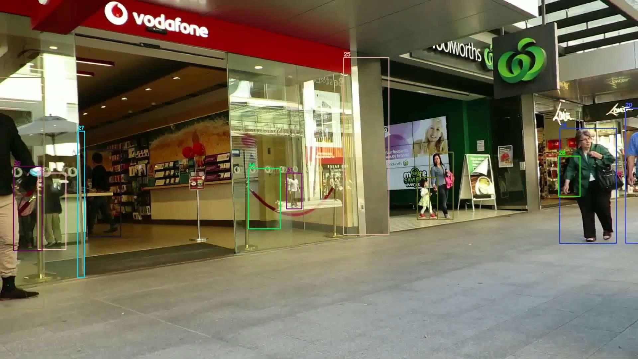
Introduction MOT16
Containing 11235 images of belonging to 14 videos
Train: 7 videos with 5316 images, Test: 7 videos with 5919 images
Around 300.000 Bounding Boxes belonging to around 1300 tracks
consisting of videos of walking through the streets

Slide 3
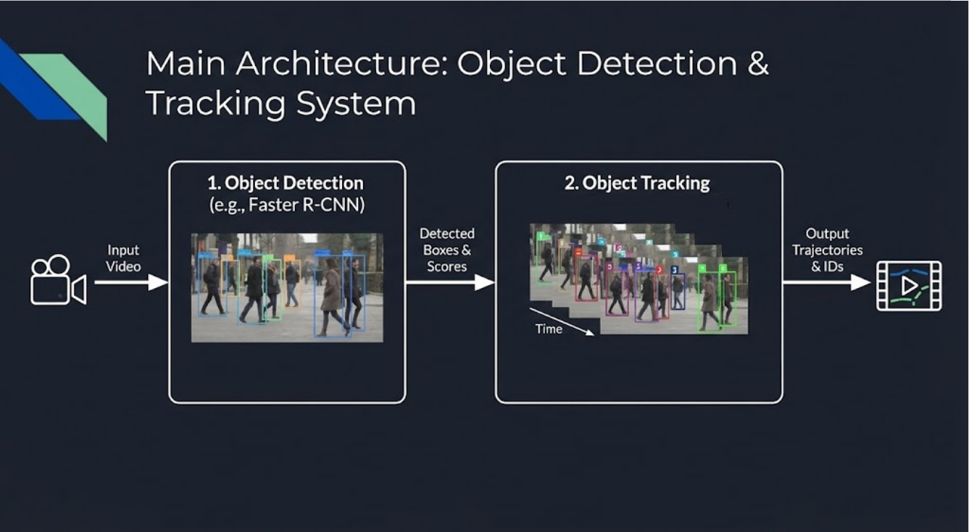
Task: Improve baseline tracker consisting of ResNet50 Backbone with Feature Pyramid Network

Slide 4

Object detection: Improvement attempts
Finetuning of the FRCNN-FPN using the CrowdHuman Dataset
Dataset consisting of images of crowded places
Make the model detect people better
Windowing approach: cut the original image into smaller overlapping windows and run them through the detector
Extremely time costly and almost no effects
Hyperparameter tuning
Change parameters such as non-visibility threshold, amount of box proposals etc.
Nothing of these approaches were finally used

Slide 5
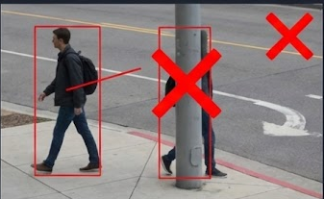
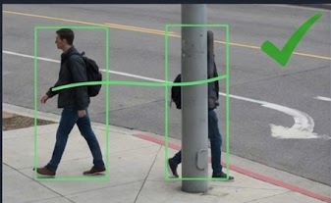
Object tracking: Bytetrack
Traditional Methods:
Discard low-confidence scores (<0.6), leading to fragmented trajectories during occlusions
Bytetrack Solution:
Keeps detetections between 0.1 and 0.6 to maintain existing tracks, prevents occlusions

Slide 6
Object tracking: NSA Kalman Filter
NSA (Noise Scale Association): The Kalman Filter's uncertainty scales with the detector's confidence (1.0−score).
Impact: When the detector is unsure, the system trusts the "momentum" of the person's previous movement. This smoothens the output.

Slide 7
Object tracking: Re-Identification
We use ResNet-18 to extract a unique identity vector for every detected person to maintain the same ID even when a person is temporarily lost or moves unpredictably.
We calculate a weighted cost combining: (0.4×IoU+0.6×App)
Spatial Overlap (IoU): Where the person should be.
Appearance Distance: Who the person looks like.

Slide 8
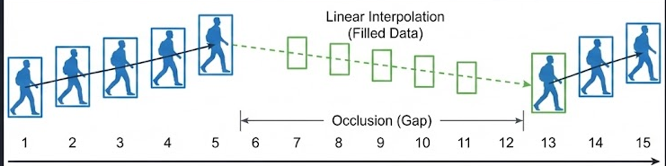
Object tracking: Post-Processing
Due to occlusion, if a specific ID disappears and reappears within a short window (up to 10 frames), the system automatically fills the missing data.
We use Linear Interpolation to calculate the intermediate bounding box coordinates,

Slide 9

Finetuned Model

Slide 10

Best Approach Video

Slide 11
Results
Secuencia | MOTA (%) | MOTP | IDF1 (%) | Precisión (%) | Recall (%) | FP | FN | IDs
MOT16-09 | 66.8% | 0.087 | 59.9% | 97.3% | 69.5% | 103 | 1,624 | 41
MOT16-10 | 65.4% | 0.152 | 49.3% | 86.1% | 81.4% | 1,688 | 2,391 | 363
MOT16-02 | 50.5% | 0.088 | 46.6% | 95.9% | 53.4% | 425 | 8,662 | 118
MOT16-04 | 77.1% | 0.100 | 80.0% | 98.9% | 78.1% | 431 | 10,433 | 48
MOT16-11 | 75.6% | 0.080 | 70.5% | 96.9% | 78.8% | 241 | 2,003 | 59
MOT16-05 | 62.3% | 0.139 | 64.8% | 94.4% | 67.8% | 278 | 2,224 | 108
MOT16-13 | 67.6% | 0.138 | 65.9% | 86.3% | 83.4% | 1,541 | 1,938 | 289
--- | --- | --- | --- | --- | --- | --- | --- | ---
OVERALL | 68.8% | 0.109 | 67.1% | 94.6% | 73.9% | 4,707 | 29,275 | 1,026

Slide 12
Video Challenge
Eric Ayestaran, Marcel Hofmann and Unax Murua

